Slide 1
BUSINESS PITCH
Subscription Delivery & Container Asset Tracking System
A rule-driven console system for managing recurring deliveries and reusable container assets.
TEAM MEMBERS
BAQUIRAN GLYNBERT P.
GERALDEZ JHUNREY B.
CABAÑERO EDRIAN B.
MONCEDA JOHN MHICO G.
TAPIC, ARJNE KYLE A.
1 / 5

Slide 2
WHY THIS SYSTEM IS NEEDED
Business Scenario & User Problem
WHO USES IT
S
The Scenario
O
Operations Admin
A company delivers 5-gallon purified water containers to homes on a weekly subscription. Every container is a physical, reusable asset that must travel from warehouse → customer → back to warehouse, in sync with each customer's billing cycle.
Manages subscriptions, inventory, and the credit ledger.
D
Delivery Personnel
Drops off full containers, picks up empties, updates status.
Without a tracking system:
Containers go missing with no record of who last held them
Deposits and refunds are miscalculated by hand
Deliveries are missed when due dates aren't tracked
No single ledger shows a customer's balance or status
S
Subscriber-Customer
Receives recurring deliveries and holds a container between visits.
2 / 5

Slide 3
SYSTEM OVERVIEW
Core Features & Process Flow
Seven modules power a straightforward four-phase flow, from subscription to reporting.
CORE MODULES
PROCESS FLOW
Customer Management
Setup & Subscribe
1
Login, register customers, create subscriptions.
Subscription Management
Delivery Management
2
Schedule & Deliver
Assign drivers & containers, update delivery status.
Container Management
3
Return & Inspect
Delivery Receipt
Record returns, check condition, update status.
Billing & Payments
4
Bill & Report
Reports
Record payments, balances, generate reports.
3 / 5

Slide 4
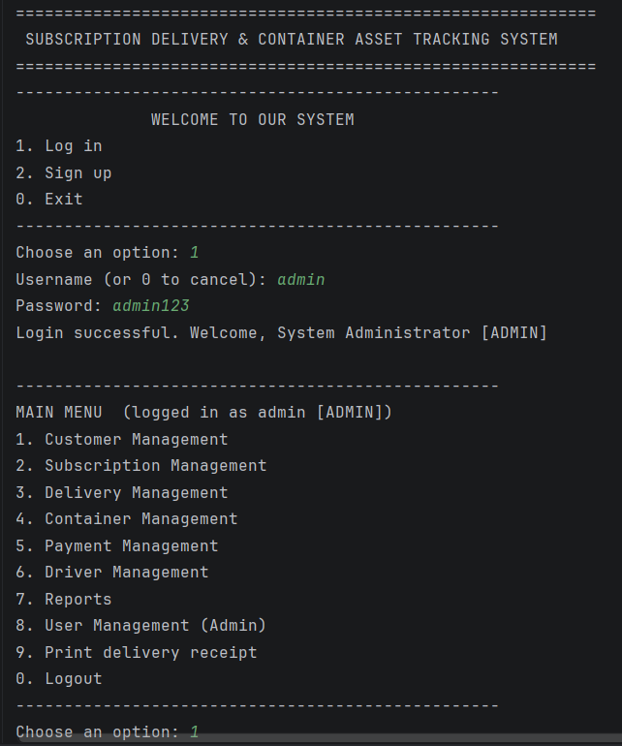
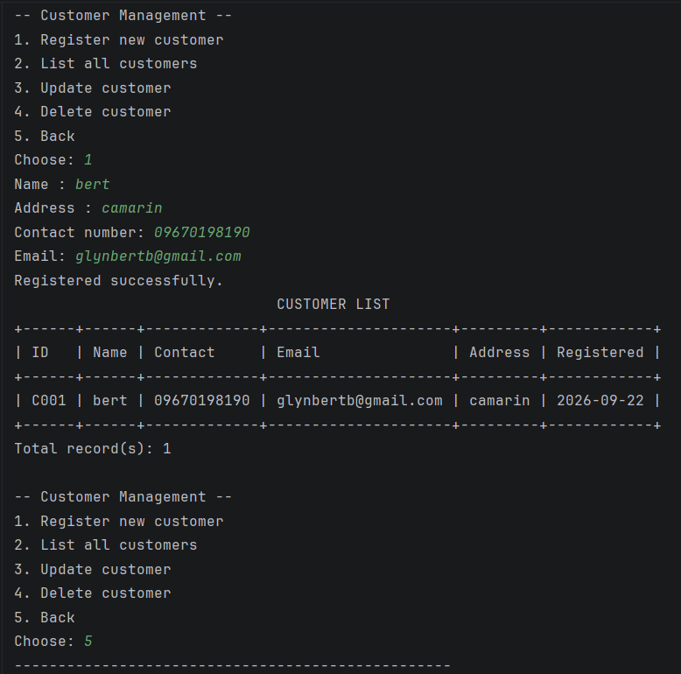
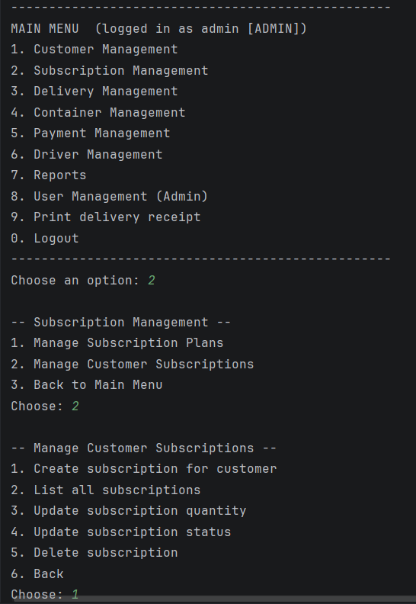
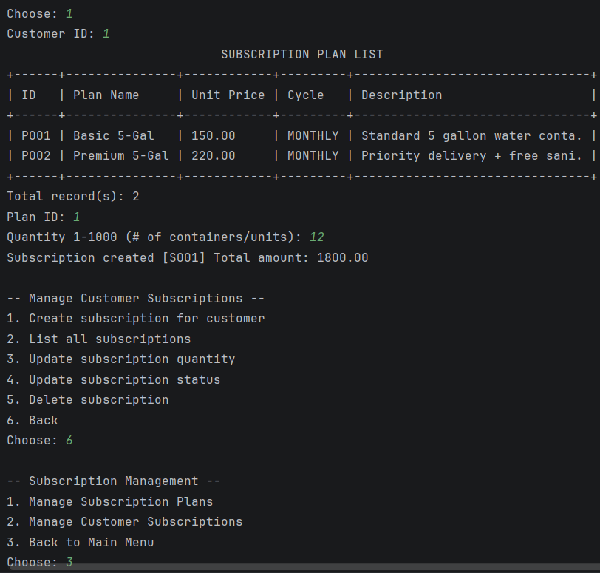
SEE IT RUN
Live Console Demonstration
2. Go to customer management to register a customer because it doesn’t have a seeded customer.
3. Then go to subscription management to create subscription to the customer. Afterwards go back to the main menu.
1. Log in the seeded admin account
5 / 5

Slide 5
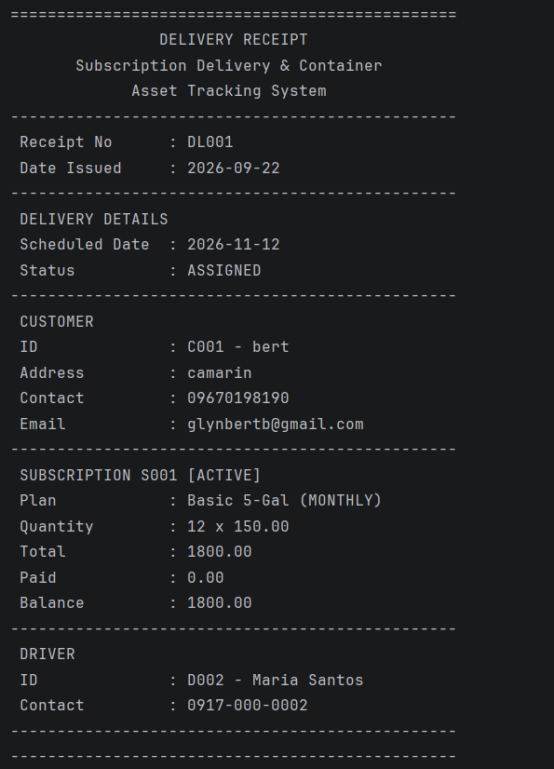
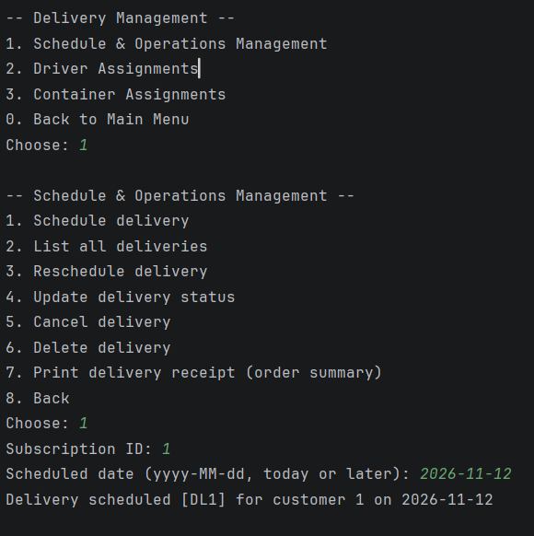
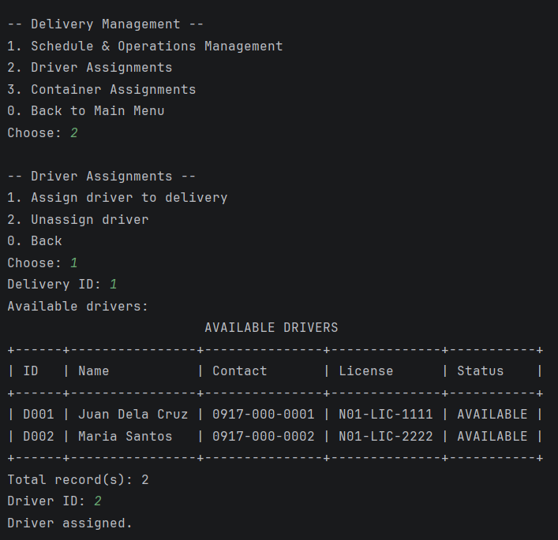
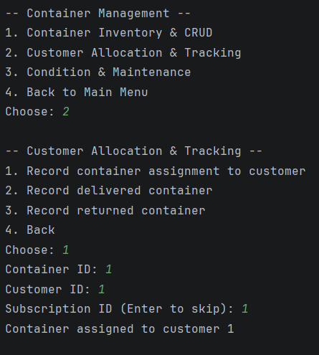
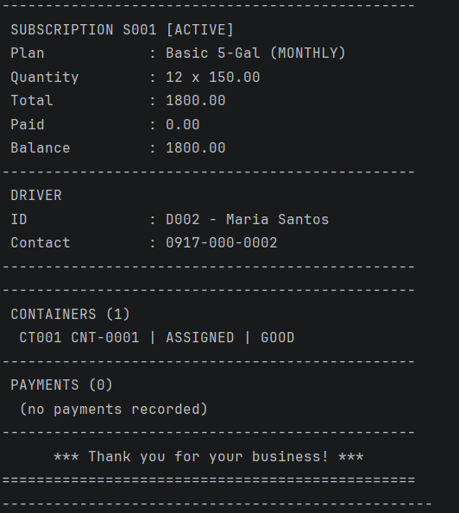
SEE IT RUN
6. Go to the main menu again and look for receipt.
Live Console Demonstration
5. Back to the main menu and go to container management to choose a container by ID and the customer ID whom to deliver the container and as well as the subscription ID.
4. Go to delivery management to schedule delivery and assigned driver to deliver the container.
5 / 5

